Slide 1

Profilic Web Application

Slide 2
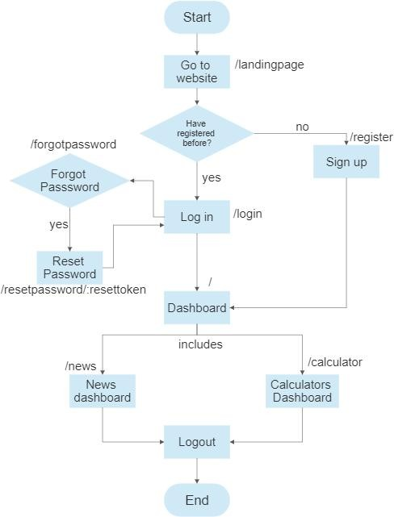
Data Flow Diagram:--

Slide 3
Use Cases:--
Calculator
AI News
Motivational Thoughts
User
Server
Weather
Voice Speech

Slide 4
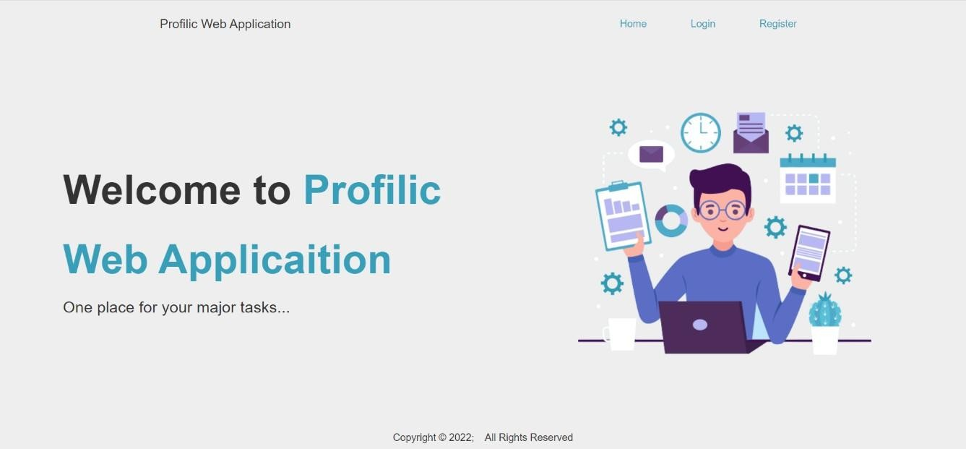
Snapshots:--
Login page of Profilic Web Application
Landing page of Profilic Web Application

Slide 5
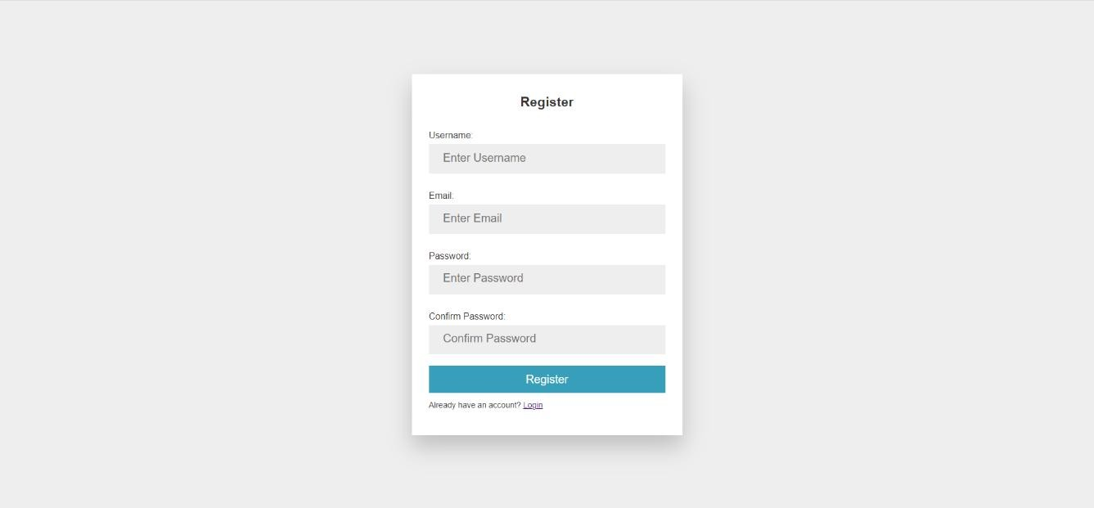
Register page of Profilic Web Application
Forgot page of Profilic Web Application

Slide 6
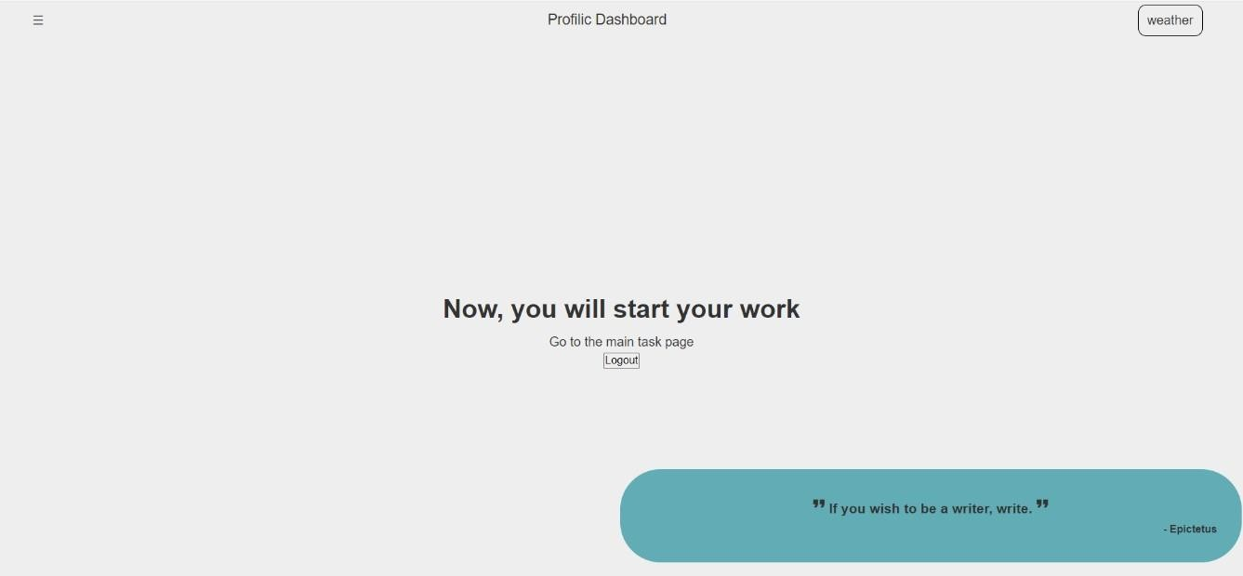
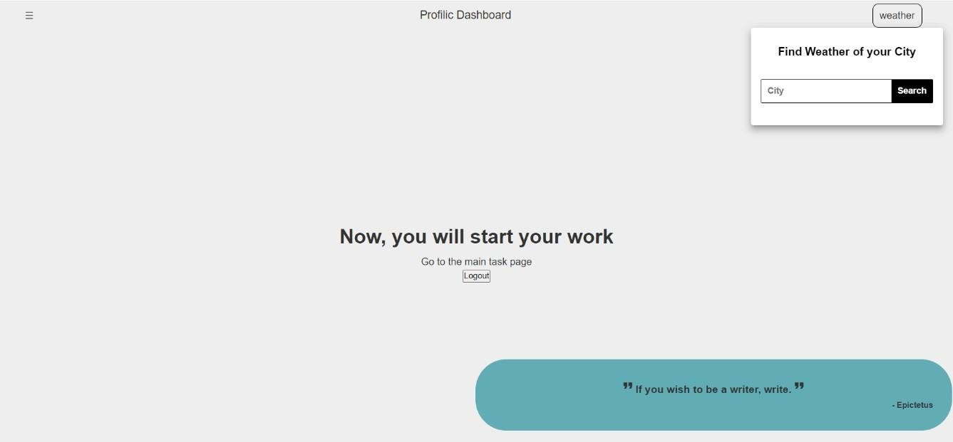
User Dashboard page of Profilic Web Application
Show Weather Component available in user dashboard of Profilic Web Application

Slide 7
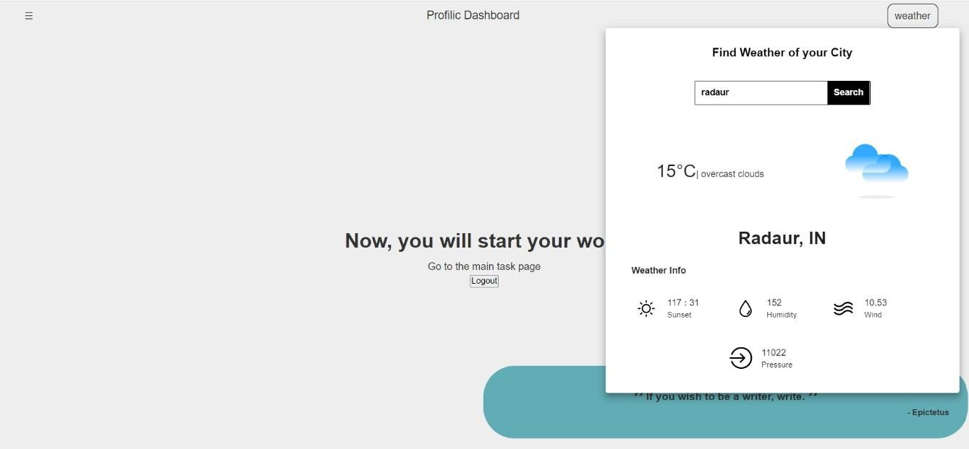
Whole Weather Component available in user dashboard of Profilic Web Application
News Section of Profilic Web Application

Slide 8
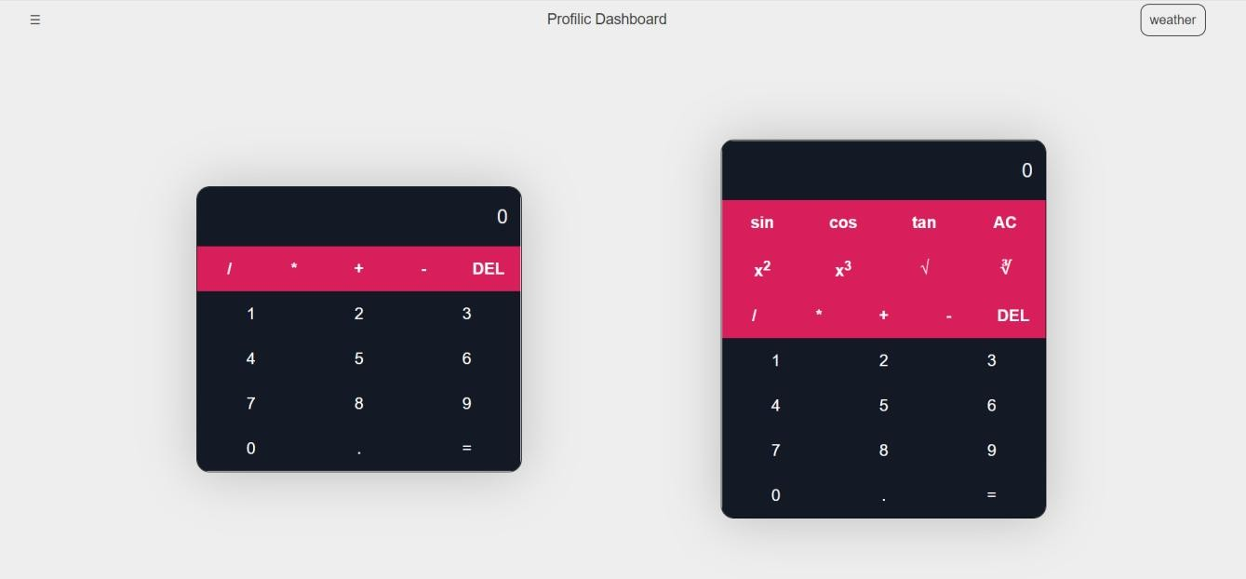
Calculator Section of Profilic Web Application

Slide 9
Thank You

